Slide 1
Magnetic Lens: Parameter Scan, Double Lens
CaOH Subgroup Meeting
Tuesday, August 18, 2020

Slide 2
Outline
Halbach cylinder as magnetic lens
Acceleration
Positioning
Tune-Ups
Double Lens
Zeeman-Sisyphus
Next steps

Slide 3
Halbach Cylinder
Leverages Halbach Array
Specifically, a Halbach cylinder
Confined magnetic field
Attenuated outside the magnet
Hexapole configuration of of 12 permanent 1T magnets
Uniformly magnetized, spatially rotating magnetic field
Mathematica, used Radia magnetostatics package
ESRF

Slide 4
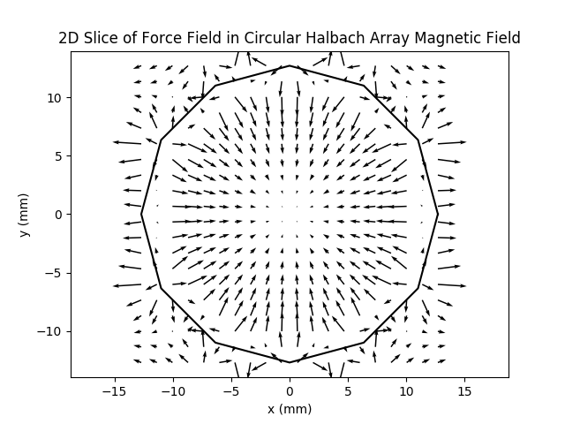
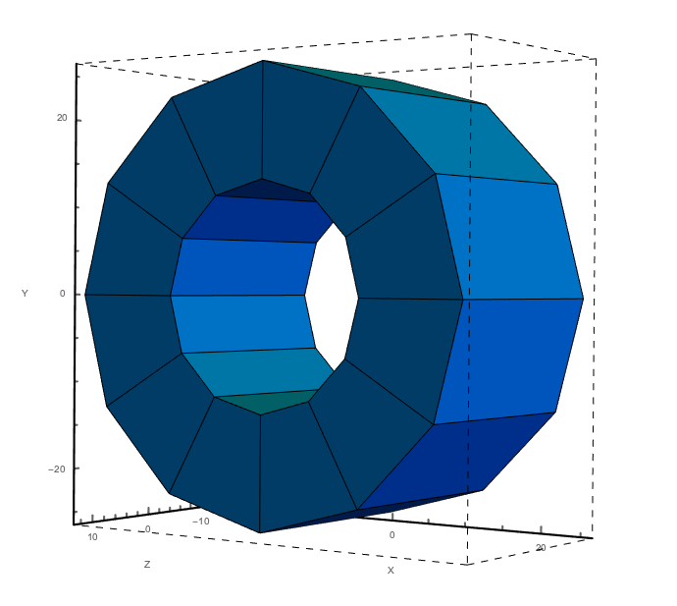
Halbach Cylinder
Inner bore radius: 12.5 mm, outer radius: 25.4 mm
Axial length: 25.4 mm
k = 4

Slide 5
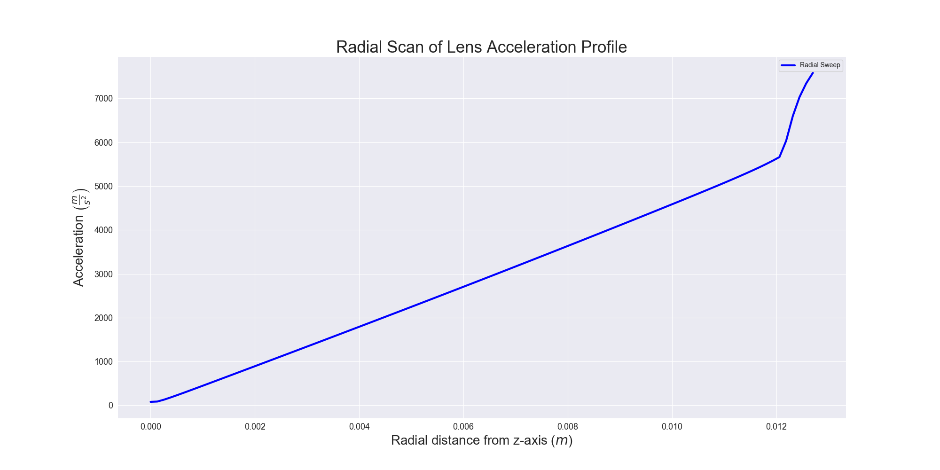
Acceleration Profile

Slide 6
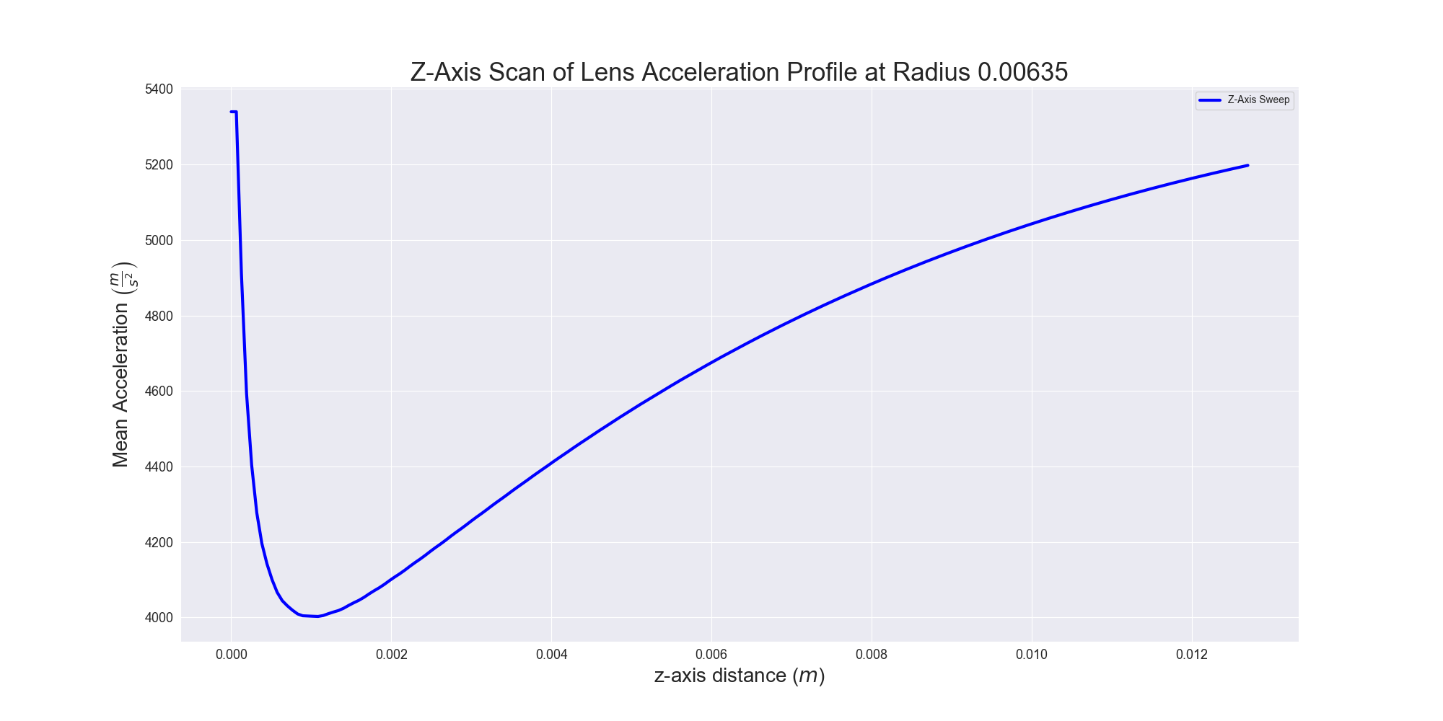
Acceleration Profile

Slide 7
Experimental Setup: Single Lens
4K Aperture,
1 cm
Beam Shutter,
1.4 cm
2.54 cm
Cell
10 cm
Varied
Lens
32 cm
MOT Region

Slide 8
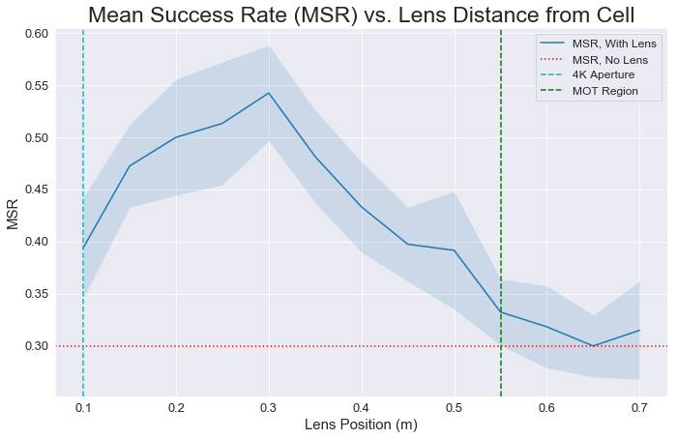
Parameter Scan
Yield ratio peaked when lens situated about 30 cm from cell aperture

Slide 9
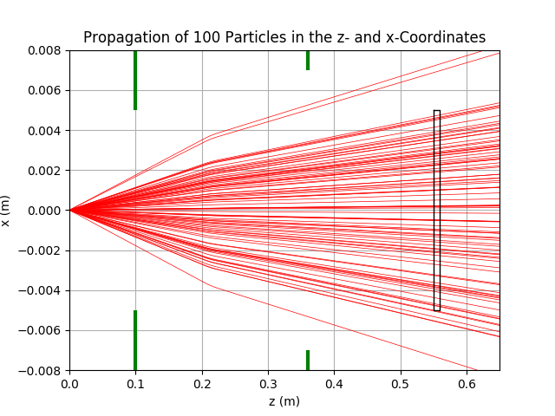
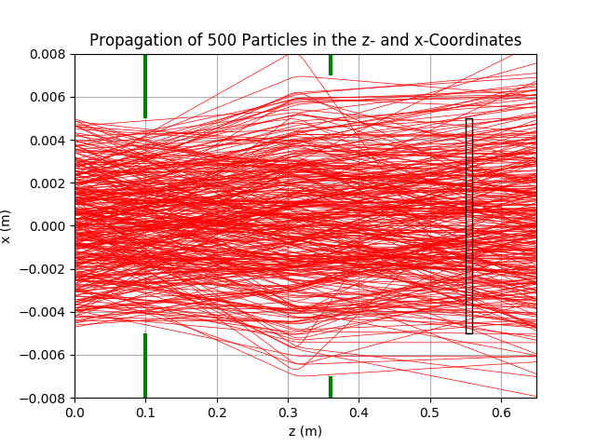
Parameter Scan

Slide 10
Experimental Setup: Double Lens
4K Aperture,
1 cm
Beam Shutter,
1.4 cm
2.54 cm
2.54 cm
Cell
10 cm
Varied
Lens
Varied
Lens
20 cm
MOT Region

Slide 11
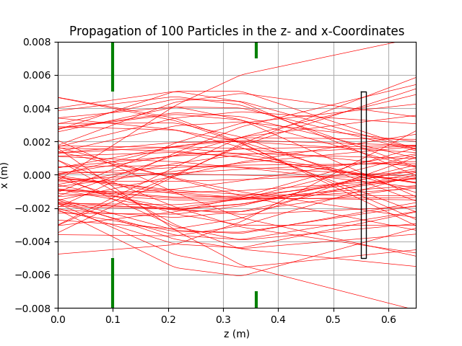
Double Lens: Preliminary Results
Yield ratio: quite high, able to capture ~70-80% of particles
Still need to generate full heatmap with 2D scan, pipeline WIP

Slide 12
Next Steps
Further Tune-Ups
Double Lens 2D Scan
Zeeman-Sisyphus
Simple analytical form of B-field
Accurate B-field model, spin sign change with optical pumping → slowing

Slide 13
Experimental Setup: Zeeman-Sisyphus Preliminary
4K Aperture,
1 cm
Beam Shutter,
1.4 cm
2.54 cm
Cell
10 cm
30 cm
Lens
32 cm
MOT Region
Constant Deceleration

Slide 14
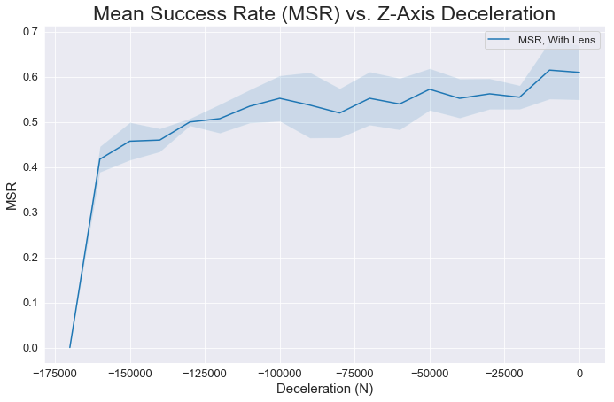
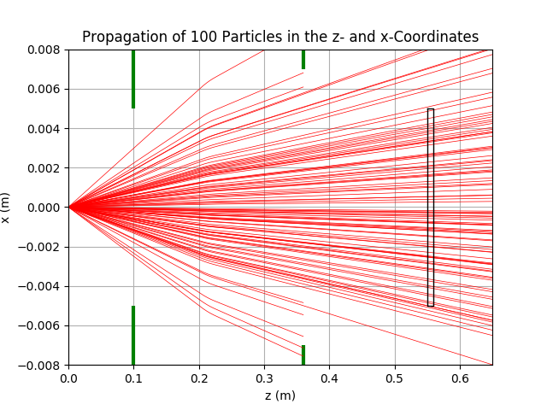
Constant Deceleration: Exploration

Slide 15
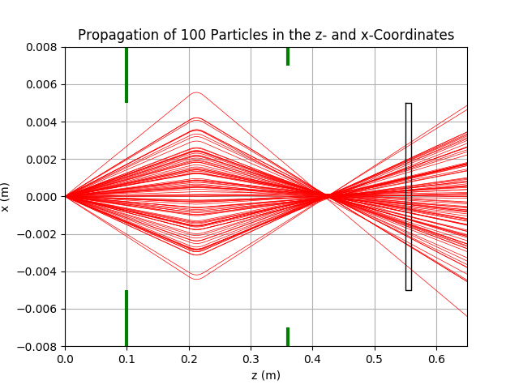
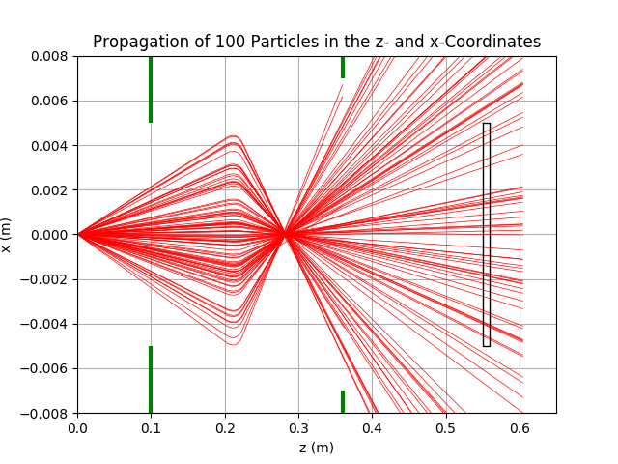
Constant Deceleration: Exploration
0 m/s², force prefactors multiplied by 5
-1.5E5 m/s², force prefactors multiplied by 5

